Slide 1
Automatic Face Detection & Replacement
Richard Arietta & Daniel Rerucha
CIS581 Fall 2014

Slide 2
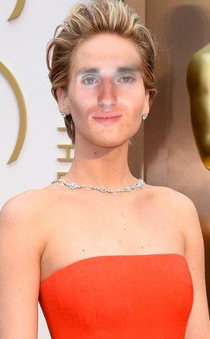
Overview of Algorithm
Program can be divided into two main parts
Part I: Face Detection and Replacement
Part II: Poisson Blending

Slide 3
Part I: Face Detection & Replacement
Program uses third-party feature detection code
Specifically, we utilize MATLAB’s feature detector class, CascadeObjectDetector
Detector includes pre-trained classifications for face, nose, mouth, and individual eyes (among other things)

Slide 4
Part I: Face Detection & Replacement
Unfortunately, ran into a lot of false positives
Make assumptions about placement of features within face and provide checks
Assume correct LeftEye is left-most feature
Assume correct RightEye is right-most feature
Assume correct Mouth is lowest feature

Slide 5


Slide 6
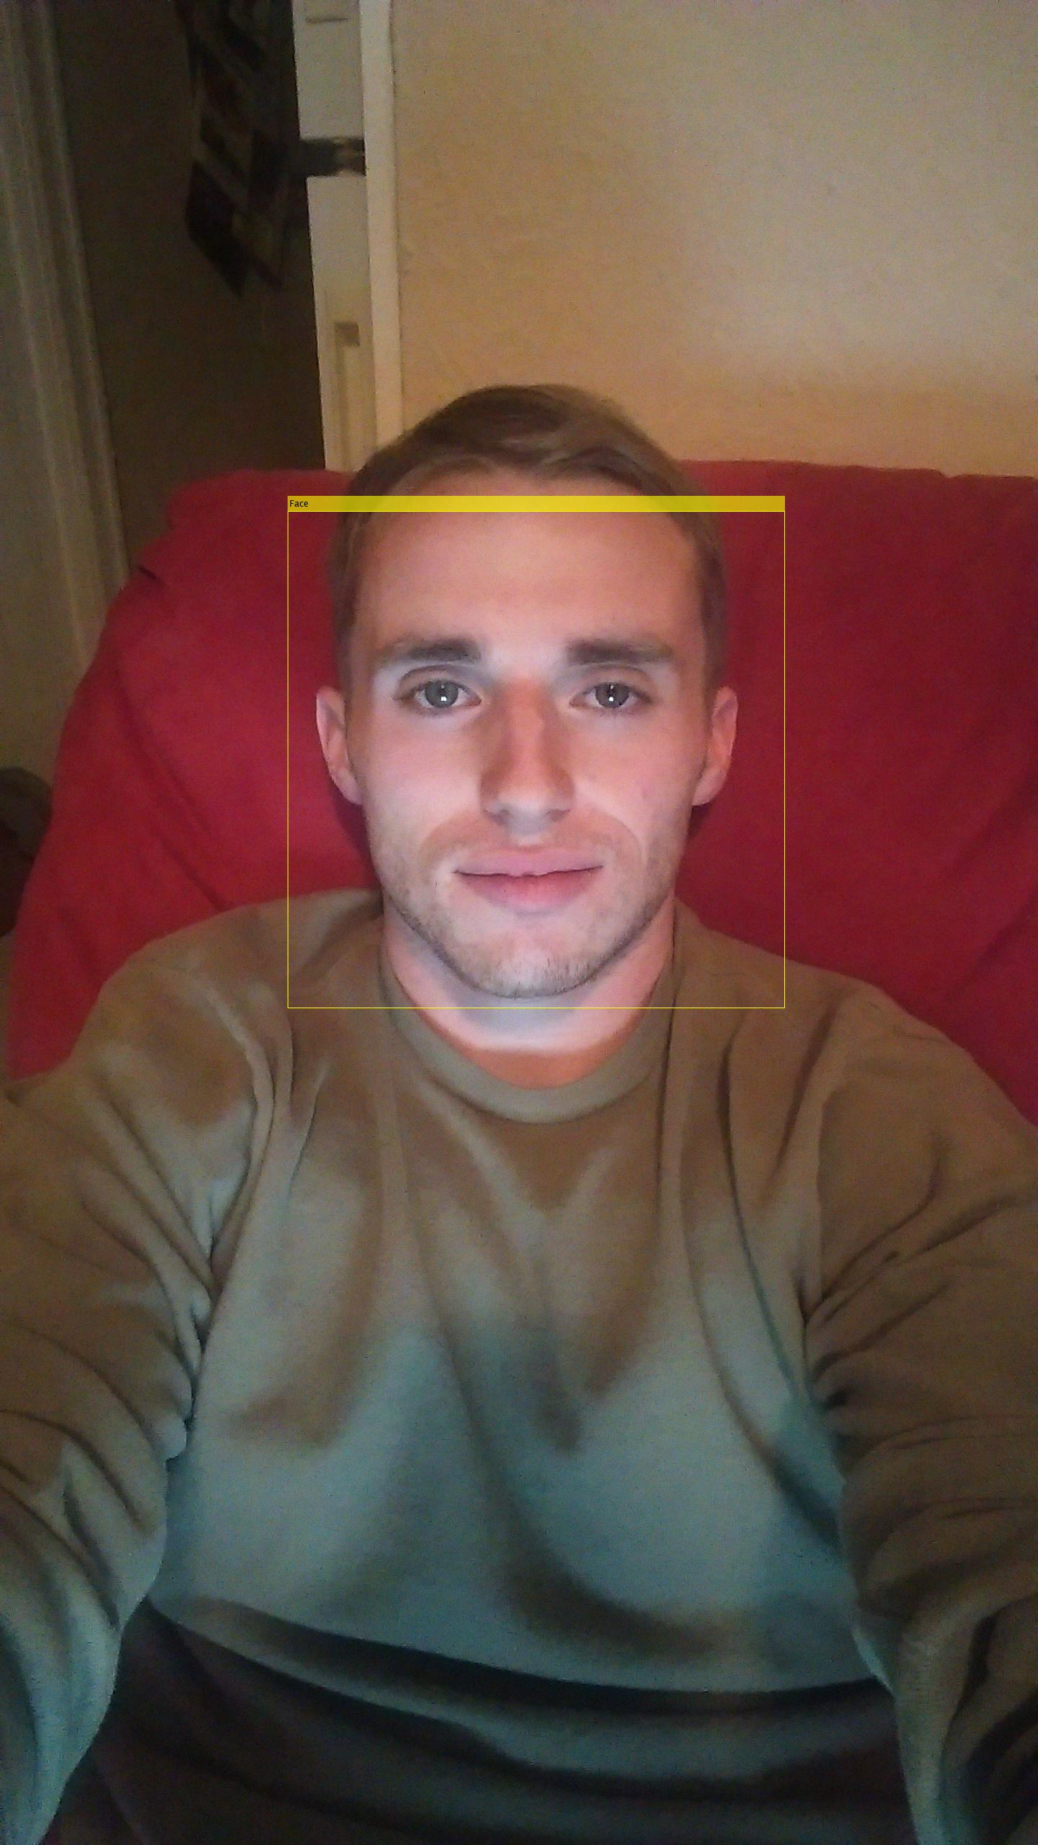

Slide 7
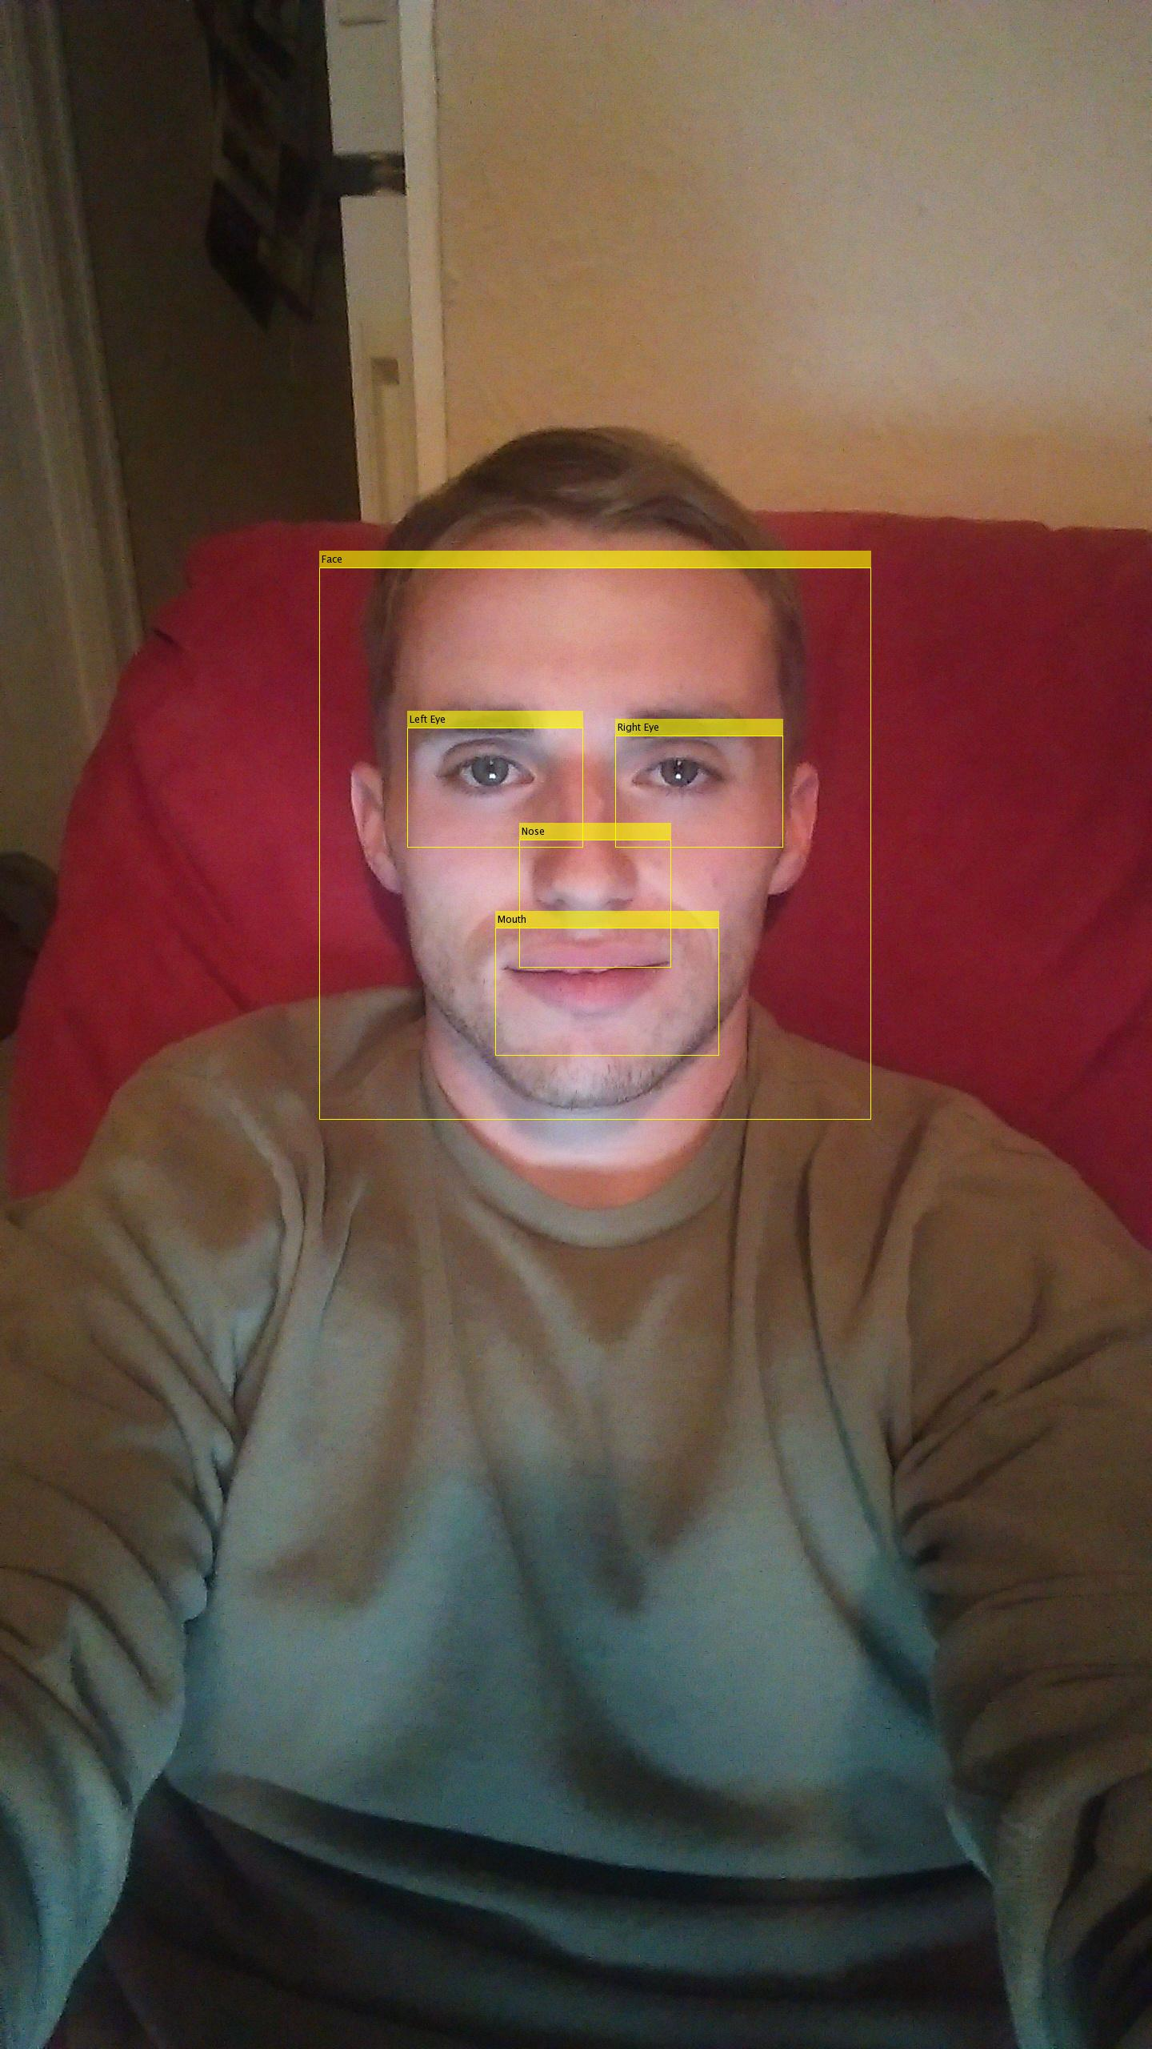

Slide 8
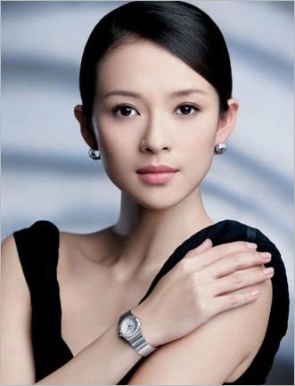

Slide 9
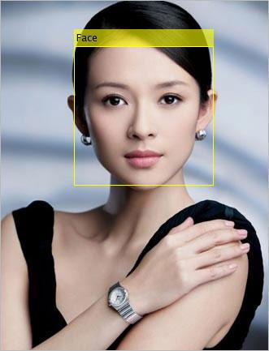

Slide 10
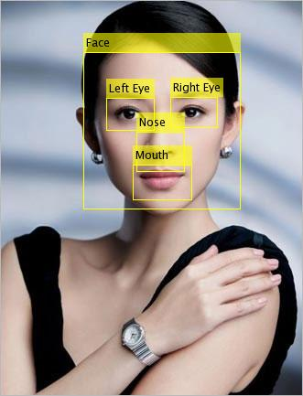

Slide 11
Part I: Face Detection & Replacement
Take center point of each detected feature (nose, mouth, right eye, left eye) as well as the two lower corners of the face’s bounding box as control points
Use code from project 03 to create a projective warp homography from the corresponding control points
Project facial region of reference image onto target input image

Slide 12
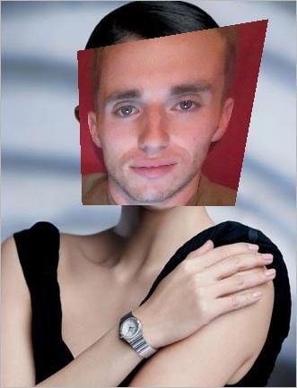

Slide 13

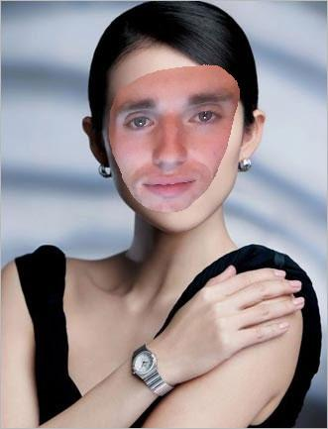
Alpha mask
+
=

Slide 14
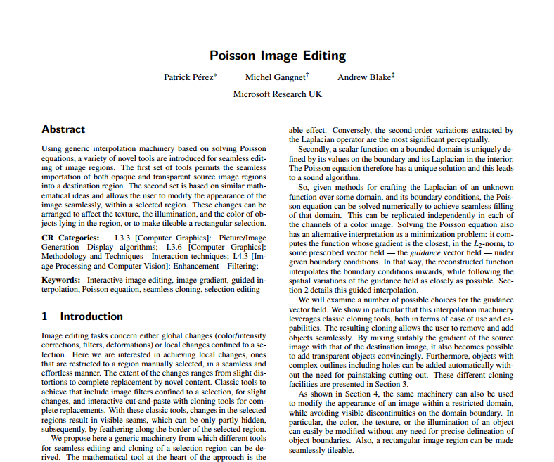

Slide 15
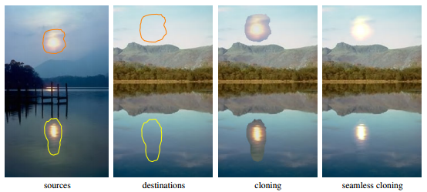
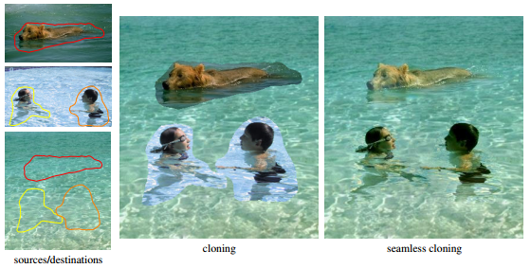
Part II: Poisson blending
Perez
Notes:
[High-level idea behind algorithm.]

Slide 16
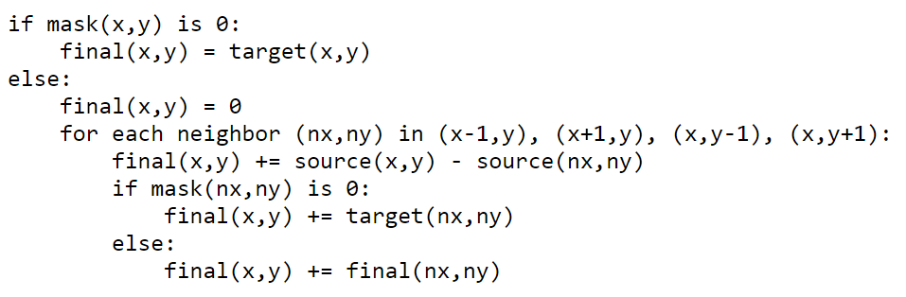
Part II: Poisson blending
Pseudocode for blending algorithm.
Ax = b.
Evan Wallace

Slide 17


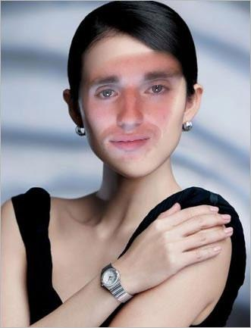
Part II: Poisson blending
Used Jacobi method to solve sparse linear system.
1 iteration
10 iterations
100 iterations

Slide 18


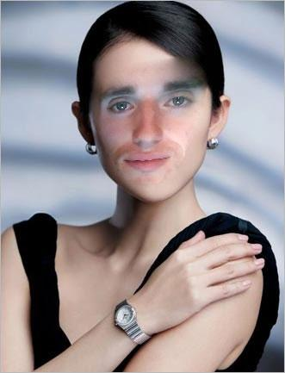


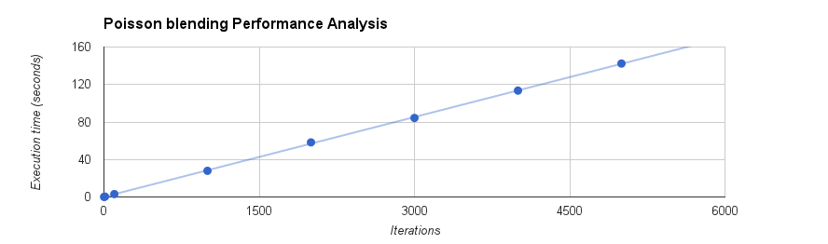
Part II: Poisson blending
1000
2000
3000
4000
5000

Slide 19
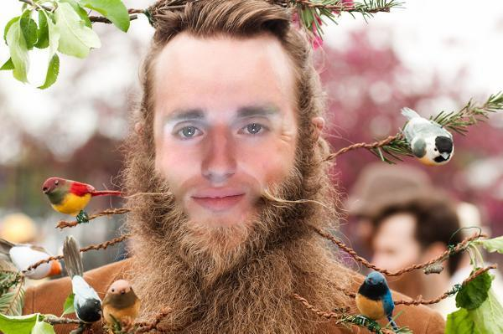
Results

Slide 20
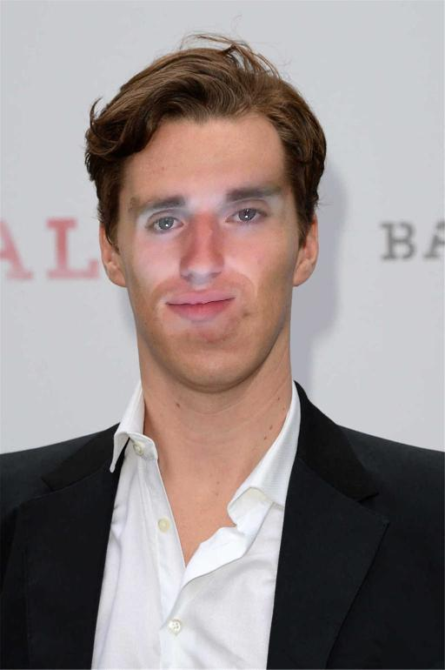

Results

Slide 21
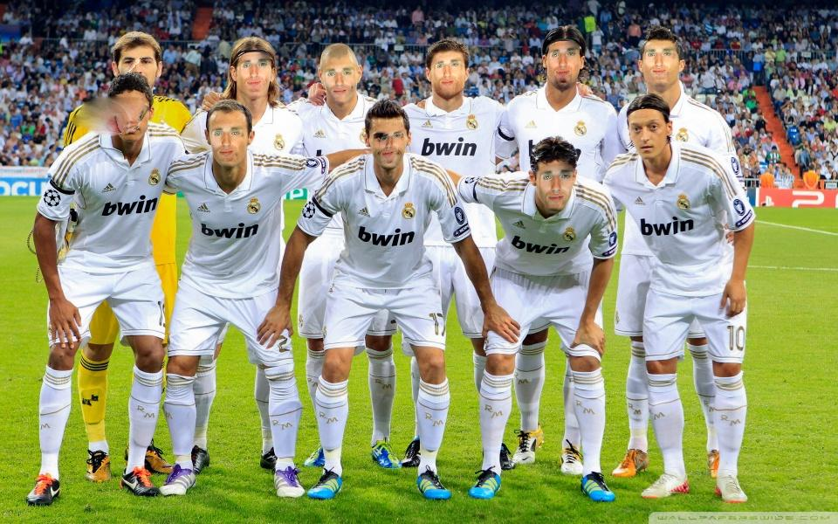
Results

Slide 22
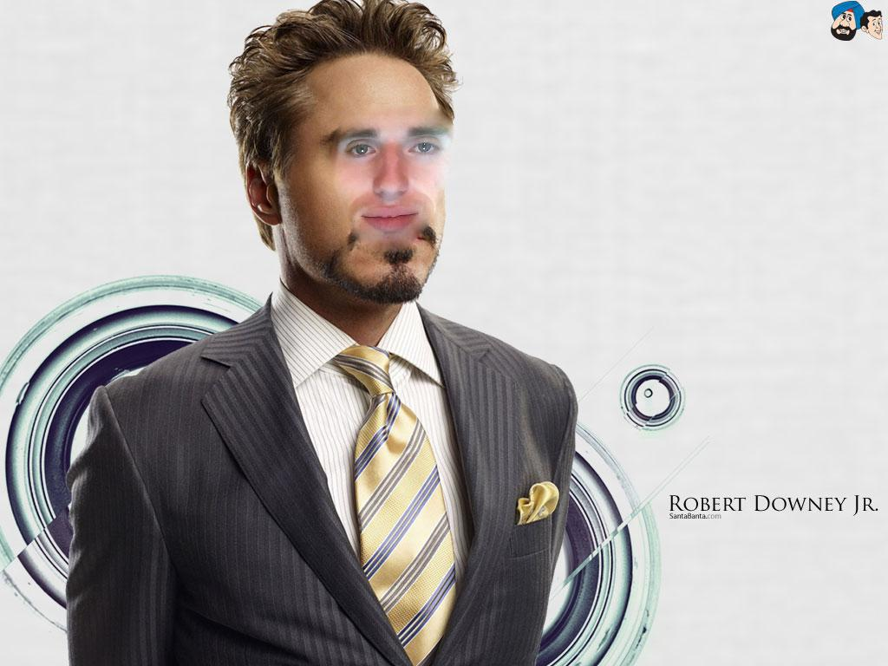
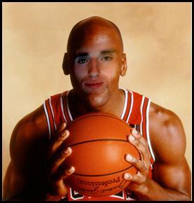
Results

Slide 23
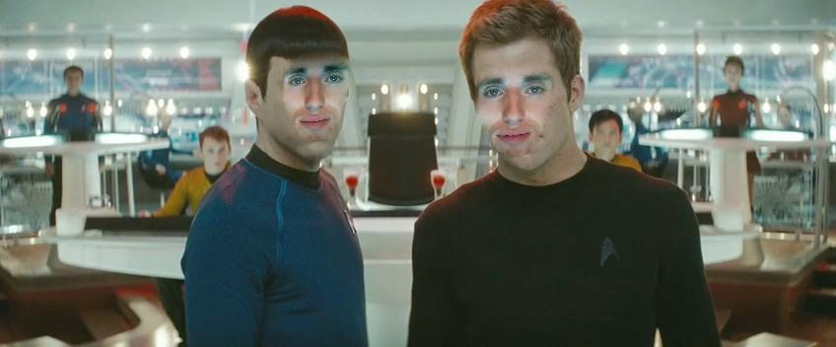
Results

Slide 24
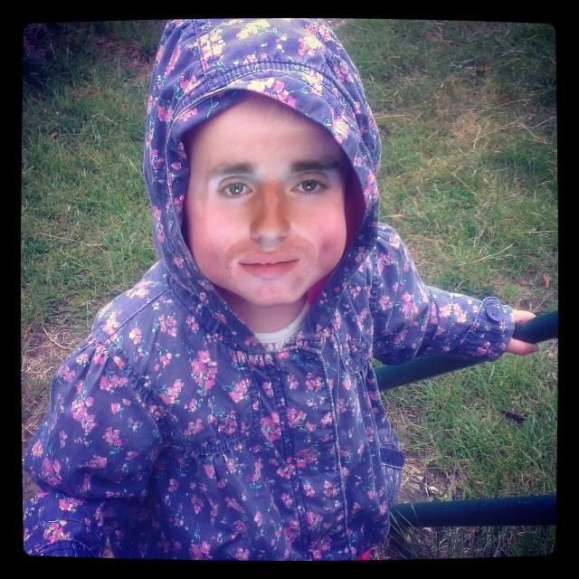
Results

Slide 25
Thank You!

